Slide 1
Java Operator
ICS 2 – Introduction to Computer Programming

Slide 2
Operators
Symbols representing operations that can be performed on constants and variables
Types of Java Operators
Assignment Operator
Arithmetic Operators
Increment and Decrement Operators
Relational Operators
Logical Operators
Conditional Operator

Slide 3
Assignment Operator
Used to store or assign a value from the right-hand side of an expression to the left-hand side.
Symbol used is =
Syntax:
<variable_name>=<expression>;

Slide 4
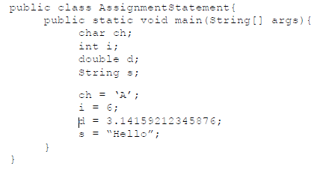
Note that it is also possible to assign a value of a variable to another variable
Example:
X=5;
Y=X;

Slide 5
Storing Values with Different Type
There are automatic conversions that can take place among different data types.
Conversions from int to double/float, char to int and char to double/float are acceptable
Example:
int i = 65;
char c = i;

Slide 6
Arithmetic Operators
Also known as mathematical operators
Basic operators are:
+ addition
- subtraction
* multiplication
/ division
% modulo (yields the remainder)

Slide 7
The +, -, *, / can be used for operands of type int, float, and double
The % can only be used for int types
The + can also be used as operator for String types

Slide 8
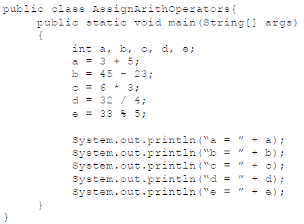

Slide 9

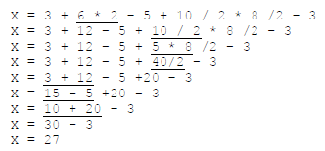
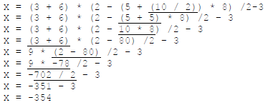
Precedence and Associativity Rule
Note: to override precedence, use parentheses to group expression

Slide 10
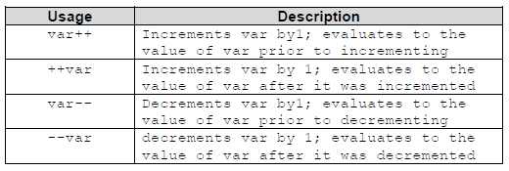
Increment and Decrement Operators
Aside from the basic arithmetic operators, the increment (++) and decerement (--) operators can be written before or after a vaiable

Slide 11


Example 1:
Example 2:

Slide 12
Relational Operators
Used to check association of the left-hand side expression to the right-hand side expression
The result of the operation yields either a true or false value
Operators:
== Equal to
!= Not equal to
> Greater than
< Less than
>= Greater than or equal to
<= Less than or equal to

Slide 13
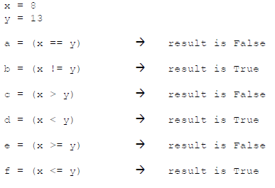
Example:

Slide 14
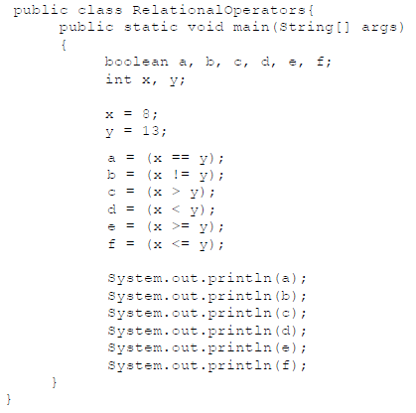

Slide 15
Logical Operators
Used to test multiple conditions and are normally used in conjunction with relational operators
Operators are:
! Logical NOT
&& Logical AND
& boolean Logical AND
|| Logical OR
| boolean Logical OR
^ boolean Logical Exclusive OR

Slide 16
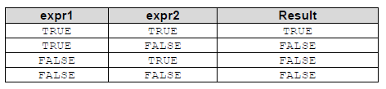
Logical AND (&&) and boolean Logical AND(&)
General idea is that if all expressions evaluated are true, the result will be true
The difference between && and & is that once an expression is evaluated as false && will not anymore evaluate the other expression since it will already yield a false value; & evaluates both expressions regardless of the value

Slide 17
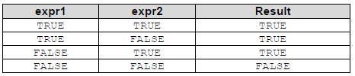
Logical OR (||) and boolean Logical OR (|)
General idea is that if one expression is evaluated is true, the statement will yield to a true value
The difference between || and | is that once an expression is evaluated as true && will not anymore evaluate the other expression since it will already yield a true value; | evaluates both expressions regardless of the value

Slide 18
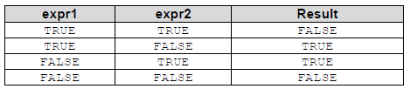
boolean Logical Exclusive OR (^)
The idea behind ^ is that the statement is true if and only if one operand is true and the other is false

Slide 19

Logical NOT (!)
A unary operator used to negate or get the opposite of a certain result in a relational operation

Slide 20
Conditional Operator (?:)
The ?: is a ternary operator since it takes three arguments that together form a conditional expression
Syntax:
expr1 ? expr2 : expr3
Idea behind ?: is that if expr1 is true, value of expr2 is returned, otherwise, expr3 is returned

Slide 21
